Slide 1
Beyond Borders: Expanding Skill Sets in Software Engineering
A talk about expansive thinking and breaking down the silos.
By: Amber Harbarger

Slide 2

About the Speaker
I’m a seasoned software engineer, starting my career in 2015. I have filled multiple roles working as an individual contributor up through a Lead Developer.
I’ve worked in a variety of environments, working on legacy systems, modern systems in the cloud, and have worked on the efforts to design the next generation systems.
I have a passion for software engineering that goes beyond the development itself, being deeply committed to community development.

Slide 3
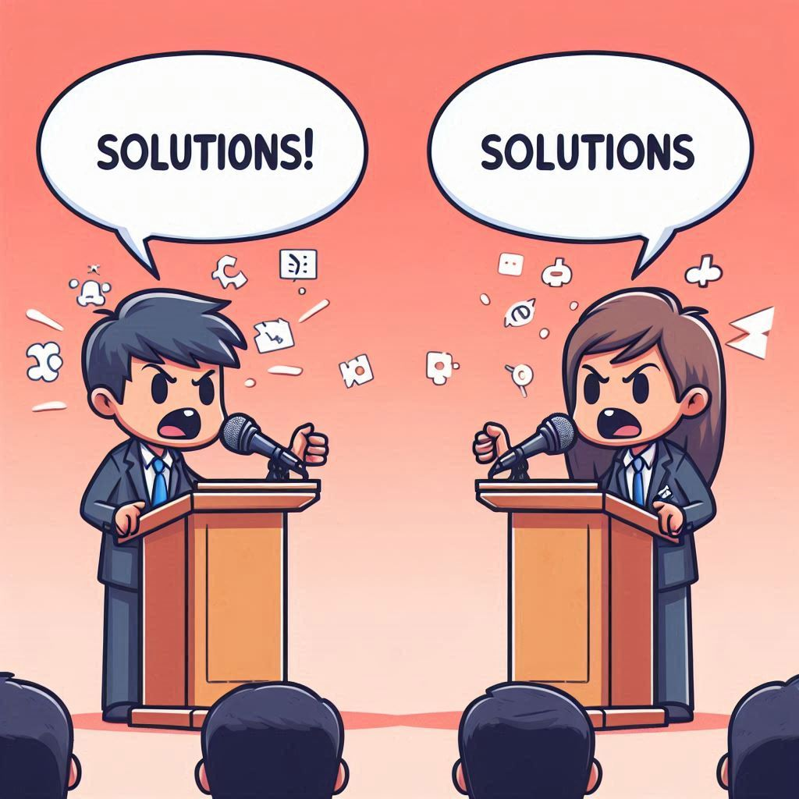
What is the problem to solve?
When I was ready to find a new opportunity a few years ago, I tried to stay in my comfort zone. Only when I embraced the unknown and took a chance, did I get the opportunity that has been paying back in dividends.
In my experience, the Framework Dogma has been my biggest hurdle to overcome. This required work on my side to remember the core fact about software engineering, there is no single catch-all framework that is great for everything.
After leaning into my discomfort and leveraging the tools I will share with you I have been able to transform from a software engineer with only a couple tools, to someone who has a full toolset that allows me to provide the best possible solution for the situation.

Slide 4
The Language Dogma
Definition: The belief that a single language or framework is a one-size fits all solution to all problems.
How Did We Get Here?
Legacy Systems and context – Longstanding companies made decisions long ago
Psychology – Cognitive Bias and Identity habits
Education & Exposure – Colleges and Boot Camps tend to focus on one or two primary languages for efficiency and time constraints
Economic – It costs to switch tooling and has dependency on the labor market
Strategic Decisions – Languages that are more mature have more tooling and there is more Vendor Lock-in in many instances
Insecurities – There is a learning curve in extending skills to new paradigms and details, which can lead to Imposter Syndrome

Slide 5
The Language Dogma – The Cost
Impacts:
Limits the creativity and stifles innovation
Limitations of certain frameworks become system limitations
Selecting less than ideal frameworks leads to risk and maintenance concerns for the future
Speed to market can be increased when using a different framework that is the right-fit
What do we do with this information?
Interesting References:
unqork The True Costs of Maintaing Legacy Systems
Excella The Real Cost of Aging IT Systems (Part 1)

Slide 6
Expanding your skillset

Slide 7
Strategies for developing your skills in new areas
Self-paced Learning: Using online learning tools to pick-up on new skills.
Project Based Learning: Work on a personal project and target to use a new language and framework. Working through the problems will help you understand strengths and weaknesses.
Open-Source Contribution: Look for Open-Source project that you might be interested or able to contribute to. This is a win-win with feedback from more experienced developers with the framework.
Community Driven: Attend or join learning groups focused on solving problems with the better solution for the situation. Use these discussions to grow your curiosity and gain insights.

Slide 8
Using Copilot and AI-Powered Tools
One of the newest set of tools that have come into our arsenal for this is Copilot and other AI-Powered tools. Learning to ask the question in a way for the LLM to respond is a new skillset to develop but will pay off as these tools increase in efficacy over time.
Learning to craft prompts for AI-Powered tools is a skill that requires finesse. A strategy for me has been using an explanation in what I want to do in general engineering principles or in the way I know to use within the confines of my “home” language, then using it to explain the answer as well.
Note: I do not take code suggestions as more than templates. I have learned to ask the tool to provide more context and sources to understand the result and will normally have to make some minor adjustments.

Slide 9
Online Learning tools and Documentation Tips
There are lots of content providers out there to distribute the content, find the one that works for you
Don’t limit yourself to only tutorial videos, look for tools that will help test your knowledge.
Anecdote: When I took a quiz in Pluralsight on Java-Spring I scored in the intermediate range because I could infer the functionality of the notation.
Most major frameworks have documentation available on starting development, use those as the primers
Learning on how to find the documentation and how to navigate it is the key skill here, not memorizing how to do something in a specific version of the framework
Take the time, do the tutorials, try out some of the items – I’ve gotten the most value by doing the tutorials and experimenting with it to see things change

Slide 10
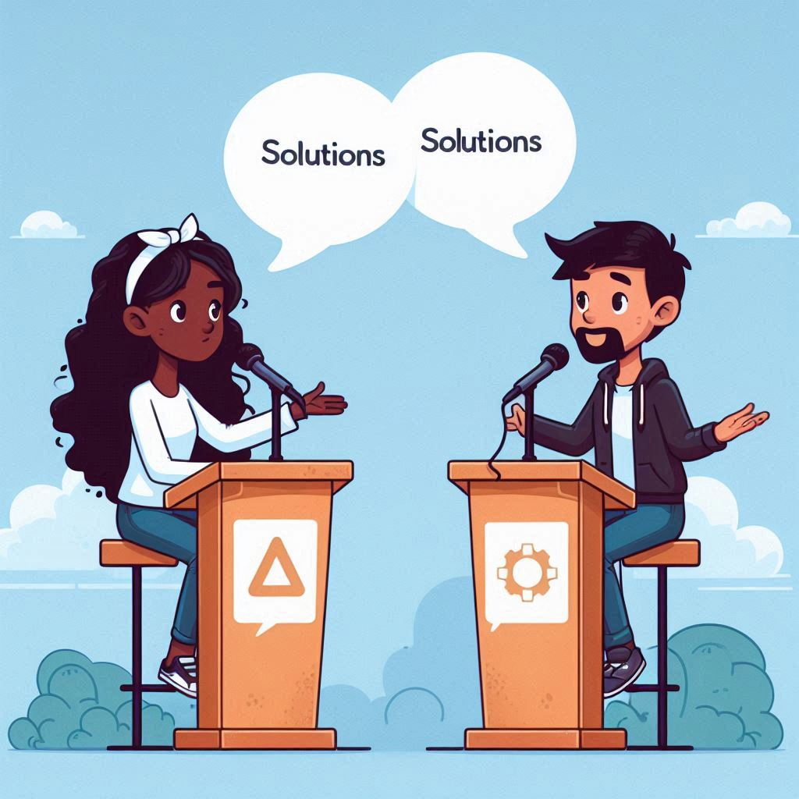
Community Building Tenants
When we build these communities, we should follow these tenants:
Breaking Down Silos: This is arguably the most important tenant. When we meet and collaborate, understand that the other person isn’t a .NET or Java developer, but a software engineer.
Encouraging Inclusive Discussions: When having discussions, don’t block out a response or a thought based on a tech stack, listen to the suggestion and listen to the rationale first.
Knowledge Sharing: For us to learn, giving others a chance to share their knowledge and experience is pivotal. Focus on the design principles and examine the results.

Slide 11

Key Takeaways
Language Dogma does exist and is a threat for the software engineering community.
Programming Languages and Frameworks are simply tools, learning to use more tools will improve our ability to use the right tool for the right job.
Leveraging the tools available to us will help us diversify our skillset and grow as individuals.
Building the community and engaging in solution driven discussions will be more fruitful than preaching dogma.

Slide 12

Call to Action & final Thought
I would encourage everyone in the room over the month to take some time and read up on a different framework or language. Follow the documentation and tutorial and try it out.
Quote:
As engineers, our greatest strength lies in our adaptability. When we confine ourselves to a single tool, we not only limit our ability to solve problems effectively but also narrow the scope of opportunities that come our way. By embracing a diverse set of skills and languages, we equip ourselves to create thoughtful, right-fit solutions, ready to meet the challenges of tomorrow, no matter what they may be.

Slide 13
Thank you
Amber Harbarger
amber@harbargerdev.com
blog.harbargerdev.com
Discord: codeamber
GitHub: harbargerdev

